Slide 1


SOFTPEDIA
FULL STACK FRONT END WEB APPLICATION
Aman Kushwaha
A new way to engage with customers from across the globe.
181500075
B.Tech CSE GLA University Mathura

Slide 2
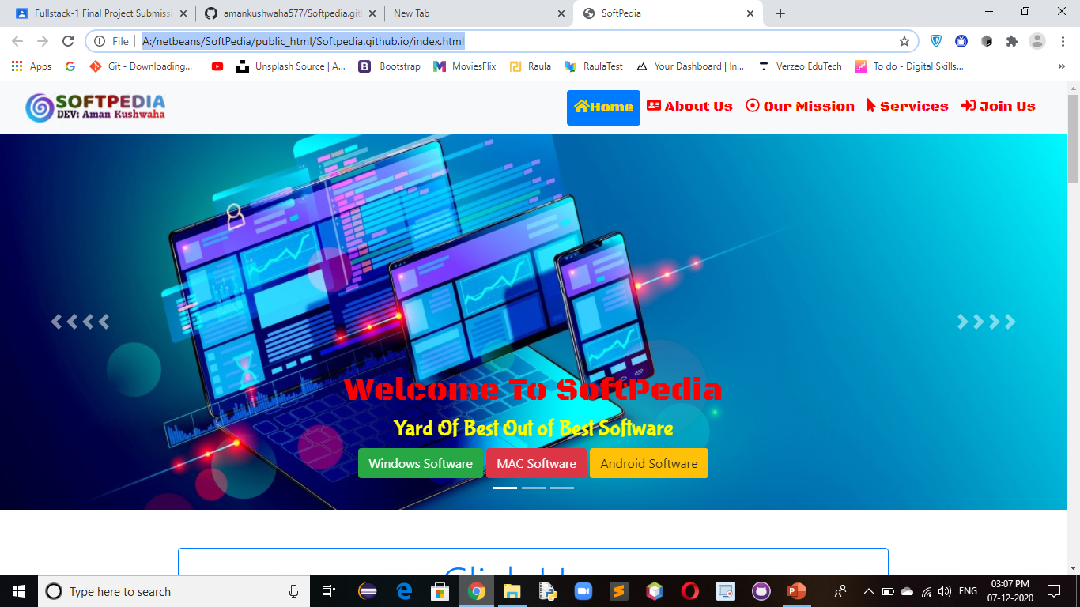
Introduction
Our Motive through this website is to provide safe and free versions of the latest software for Mac, Windows and Android than our website is specialy designed for you Softpedia is the bestway to discover Free Mac Software.
Target millions of potential users to use and engage with our app.
No need of signup/signin to our app to post/share/like the links/urls .
No Need to pay Huge amount of money.

Slide 3

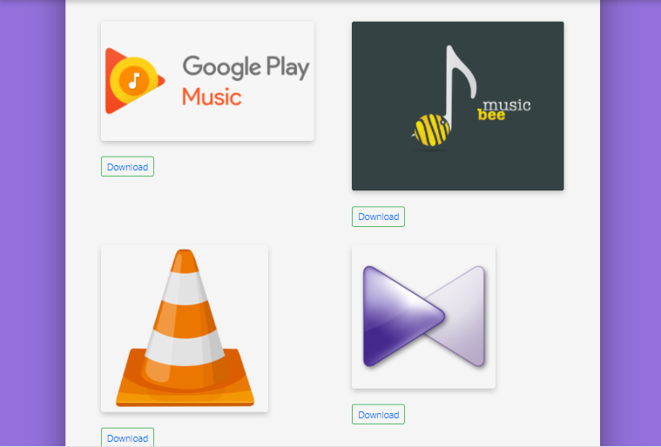
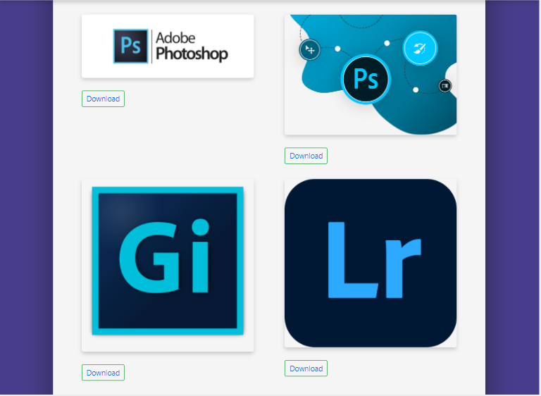

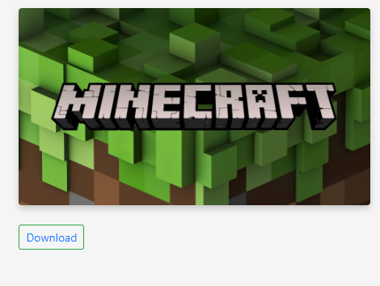




PROBLEM STATEMENT AND SOLUTION
Free Softwares
Time Saving
Software Updates
Categoriesed Softwares
Software Updates
No Need to pay Huge amount of money.
No need to search in thousands of website
Always get latest version of softwares.
Different Softwares in Different Categories.

Slide 4
Front End Framework:
This Website have 22 Web Pages ,And 3 Types of Technologies in Project.
HTML 5
CSS 3
BOOTSRAP 4 and JS
Major Portion of this Web Application covered through html 5.
HTML 5 Used- 45%
For Media Query And Website Responiveness I have used CSS 3.
CSS 3 Used – 30%
For Effects and Premade library of css classes this website uses Bootstrap and css.
Bootstrap and css used -35%

Slide 5
Hardware And Software Requirement
Software Requirement
Hardware Requirement
Windows 8.1 and above
Visual Studio Code
Web Browser
Github Desktop
Laptop/Desktop
​1.8 GHz or faster processor. Quad-core or better recommended
​ 4 GB of RAM and core i3 processor
​Hard disk space: Minimum of 500MB

Slide 6
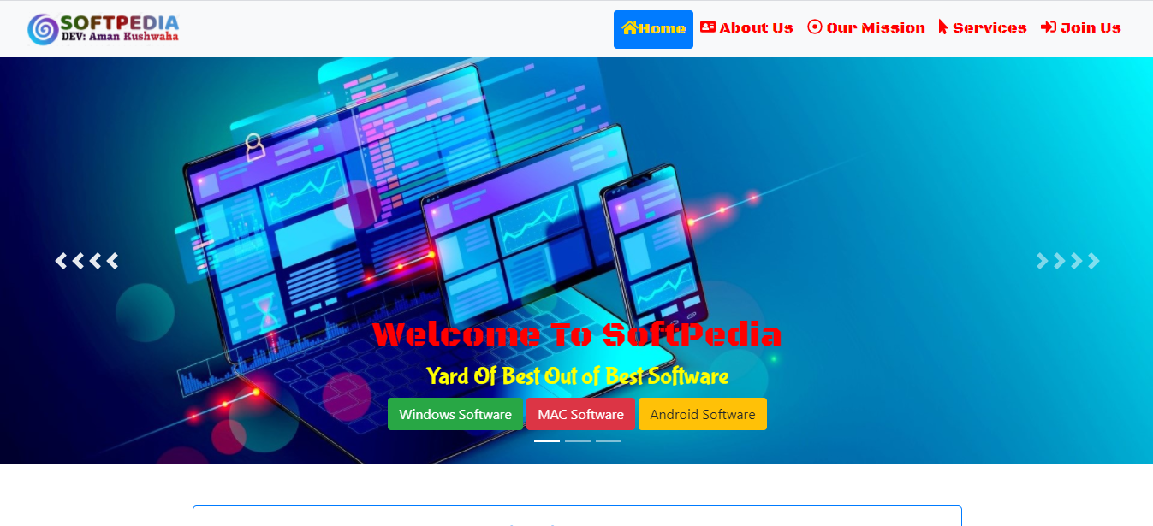
Section Divider
Home Page

Slide 7
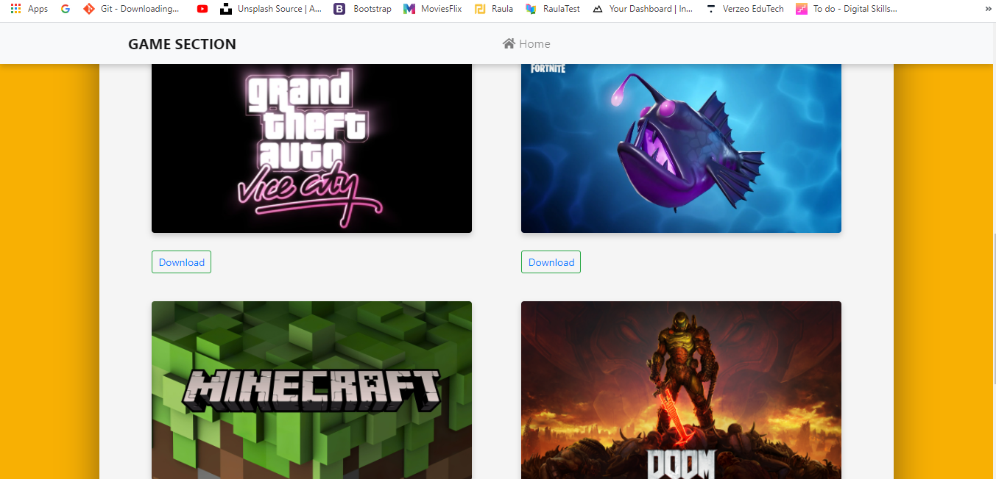
Section Divider
Game Zone

Slide 8
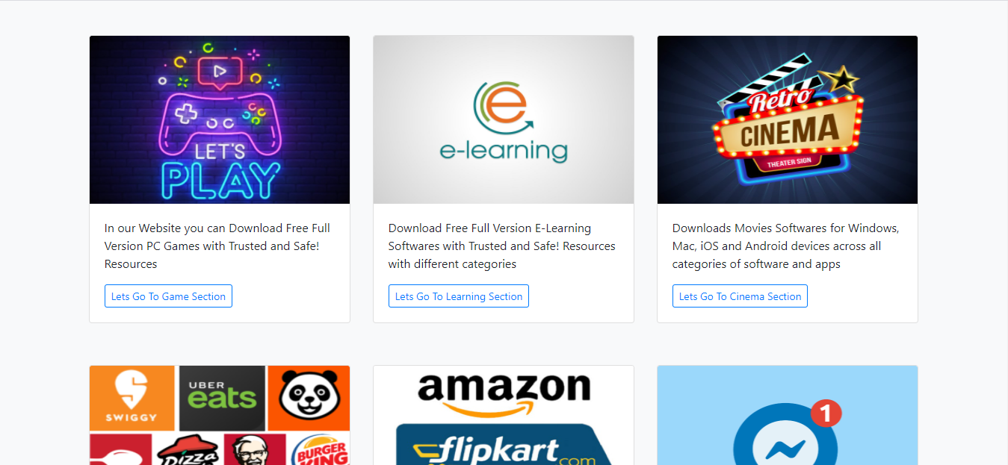
Section Divider
Different Different Section For Softwares

Slide 9


Thank You
Softpedia
Aman Kushwaha

Slide 10
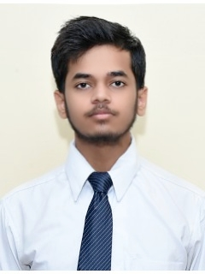

Developer:
Linkedin
https://www.linkedin.com/in/aman-kushwaha-ba0038182/
Twitter
https://twitter.com/amankushwaha57
CEO
Aman Kushwaha
B.Tech Computer Science
181500075
Sec : D

